Slide 1
Supervised Learning:Classification
Nearest Neighbor Part-1

Slide 2
Machine Learning
The field of study interested in the development of computer algorithms to transform data into intelligent action is known as machine learning.

Slide 3
Uses and abuses of machine learning
A computer may be more capable than a human of finding patterns in large databases, but it still needs a human to motivate the analysis and turn the result into meaningful action.
Machines are not good at asking questions, or even knowing what questions to ask.
They are much better at answering them, provided the question is stated in a way the computer can comprehend.

Slide 4
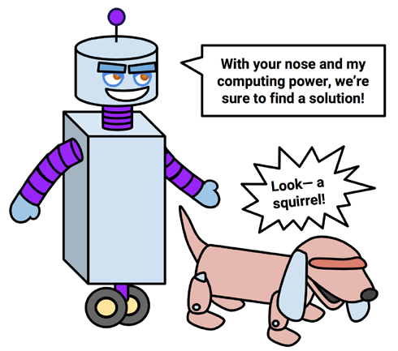

Slide 5
There are various places where machine learning is used.
Identification of unwanted spam messages in e-mail
Segmentation of customer behavior for targeted advertising
Forecasts of weather behavior and long-term climate changes
Prediction of popular election outcomes

Slide 6
Development of algorithms for auto-piloting drones and self-driving cars
Optimization of energy use in homes and office buildings
Discovery of genetic sequences linked to diseases

Slide 7
Although machine learning is used widely and has tremendous potential, it is important to understand its limits.
Machine learning, at this time, is not in any way a substitute for a human brain.
It has very little flexibility to extrapolate outside of the strict parameters it learned and knows no common sense.
Notes:
Extrapolate-extend the application of (a method or conclusion) to an unknown situation by assuming that existing trends will continue or similar methods will be applicable.

Slide 8
With this in mind, one should be extremely careful to recognize exactly what the algorithm has learned before setting it loose in the real-world settings.

Slide 9
How machines learn
Regardless of whether the learner is a human or machine, the basic learning process is similar. It can be divided into four interrelated components:
Data storage utilizes observation, memory, and recall to provide a factual basis for further reasoning.
Abstraction involves the translation of stored data into broader representations and concepts.

Slide 10
Generalization uses abstracted data to create knowledge and inferences that drive action in new contexts.
Evaluation provides a feedback mechanism to measure the utility of learned knowledge and inform potential improvements.

Slide 11
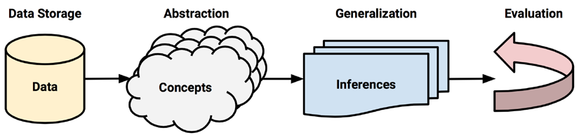

Slide 12
Machine learning in practice
Data collection
Data exploration and preparation
Model training
Model evaluation
Model improvement

Slide 13
Classification
The Classification algorithm is a Supervised Learning technique that is used to identify the category of new observations on the basis of training data. In Classification, a program learns from the given dataset or observations and then classifies new observation into a number of classes or groups. Such as, Yes or No, 0 or 1, Spam or Not Spam, cat or dog, etc. Classes can be called as targets/labels or categories.

Slide 14
Lazy learning:Nearest neighbors
Nearest neighbor classifiers are defined by their characteristic of classifying unlabeled examples by assigning them the class of similar labeled examples.
They have been used successfully for:
Computer vision applications, including optical character recognition and facial recognition in both still images and video

Slide 15
Predicting whether a person will enjoy a movie or music recommendation
Identifying patterns in genetic data, perhaps to use them in detecting specific proteins or diseases

Slide 16
The k-NN algorithm
The nearest neighbors approach to classification is exemplified by the k-nearest neighbors algorithm (k-NN).
The k-NN algorithm gets its name from the fact that it uses information about an example's k-nearest neighbors to classify unlabeled examples.
The letter k is a variable term implying that any number of nearest neighbors could be used.

Slide 17
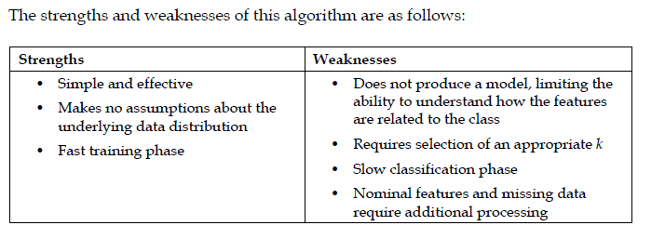
Notes:
Nominal-Nominal data is made of discrete values

Slide 18
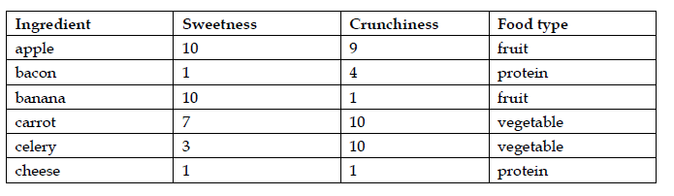

Slide 19
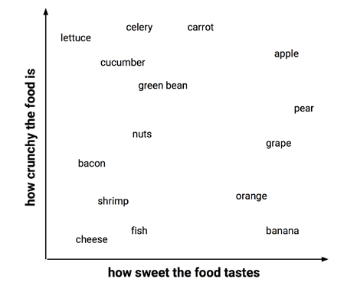

Slide 20
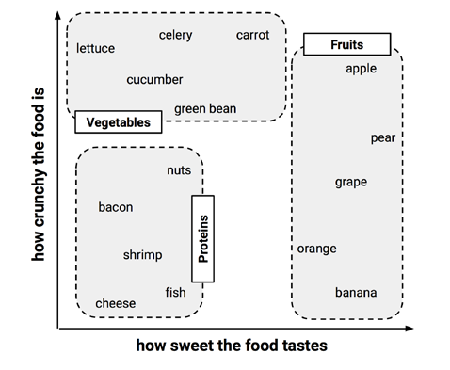

Slide 21
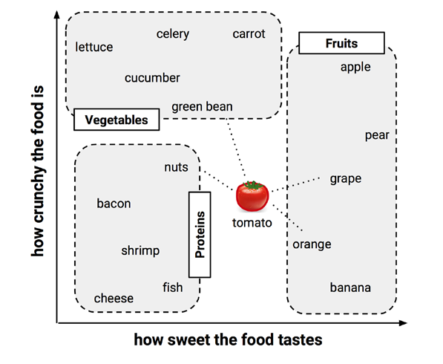

Slide 22
Measuring similarity with distance
Locating the tomato's nearest neighbors requires a distance function, or a formula that measures the similarity between the two instances.
The distance formula involves comparing the values of each feature. For example, to calculate the distance between the tomato (sweetness = 6, crunchiness = 4), and the green bean (sweetness = 3, crunchiness = 7), we can use the formula as follows:

Slide 24
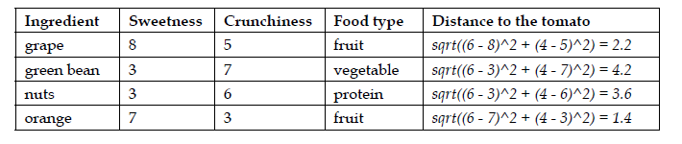

Slide 25
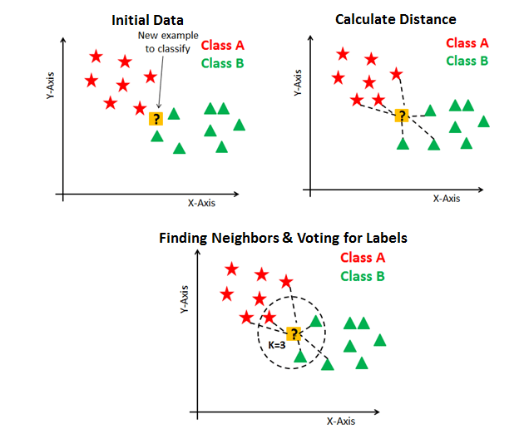
Choosing an appropriate k

Slide 26
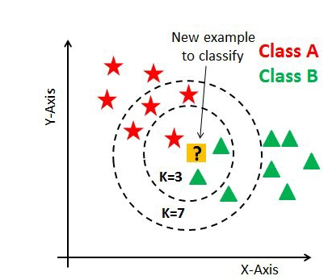

Slide 27
As you can verify from the above image, if we proceed with K=3, then we predict that test input belongs to class B, and if we continue with K=7, then we predict that test input belongs to class A.
That’s how you can imagine that the K value has a powerful effect on KNN performance.
There are no pre-defined statistical methods to find the most favorable value of K.

Slide 28
The small K value isn’t suitable for classification.
The optimal K value usually found is the square root of N, where N is the total number of samples.

Slide 29
Why KNN is Lazy?
K-NN is a lazy learner. A lazy learner is not really learning anything.
An eager learner has a model fitting or training step. A lazy learner does not have a training phase.
There is very less training time in K-NN.
This allows the training phase, which is not actually training anything, to occur very rapidly.

